Slide 1
DIP-Unit-IV -1 Representation and Description

Slide 2
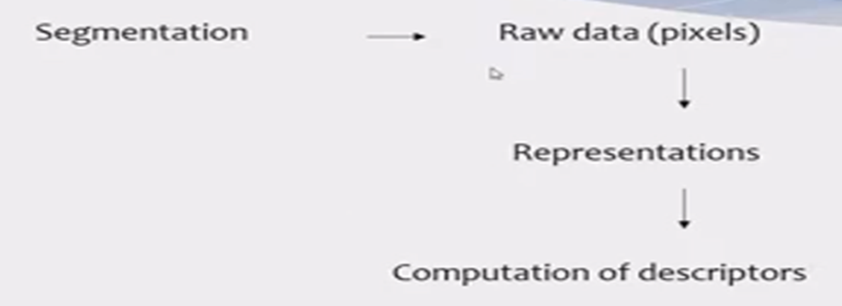
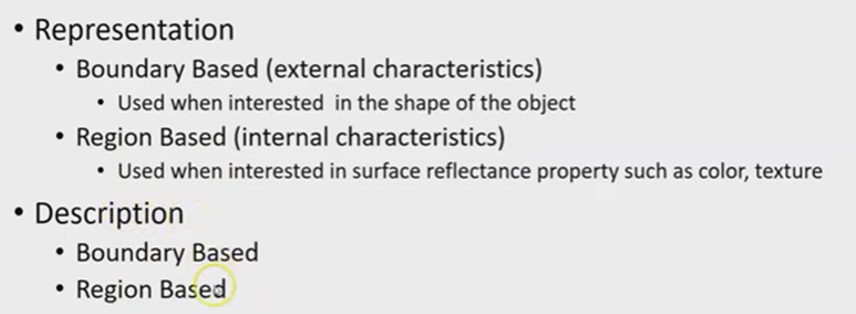
Representation and Description
Representation and description almost always follow the output of a segmentation stage, which usually is raw pixel data that constitutes either the boundary of a region or all the points in the region itself.
Description deals with extracting attributes that result in some quantitative information of interest or are basic for differentiating one class of objects from another.

Slide 3
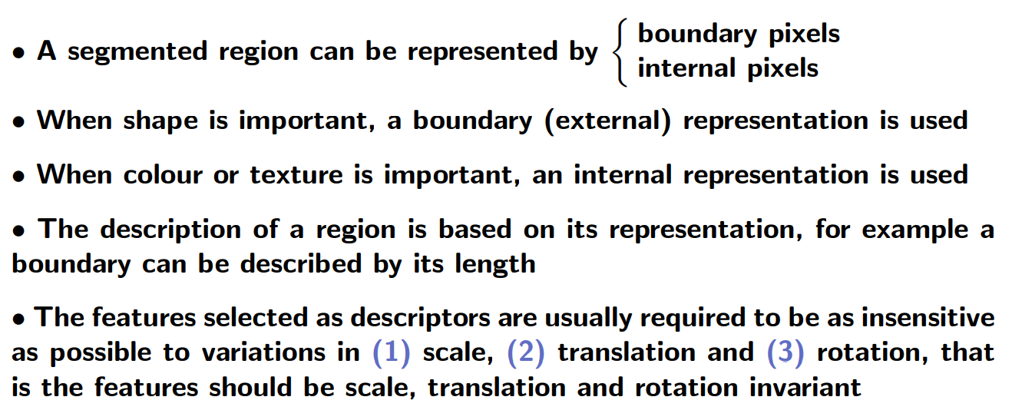

Slide 4
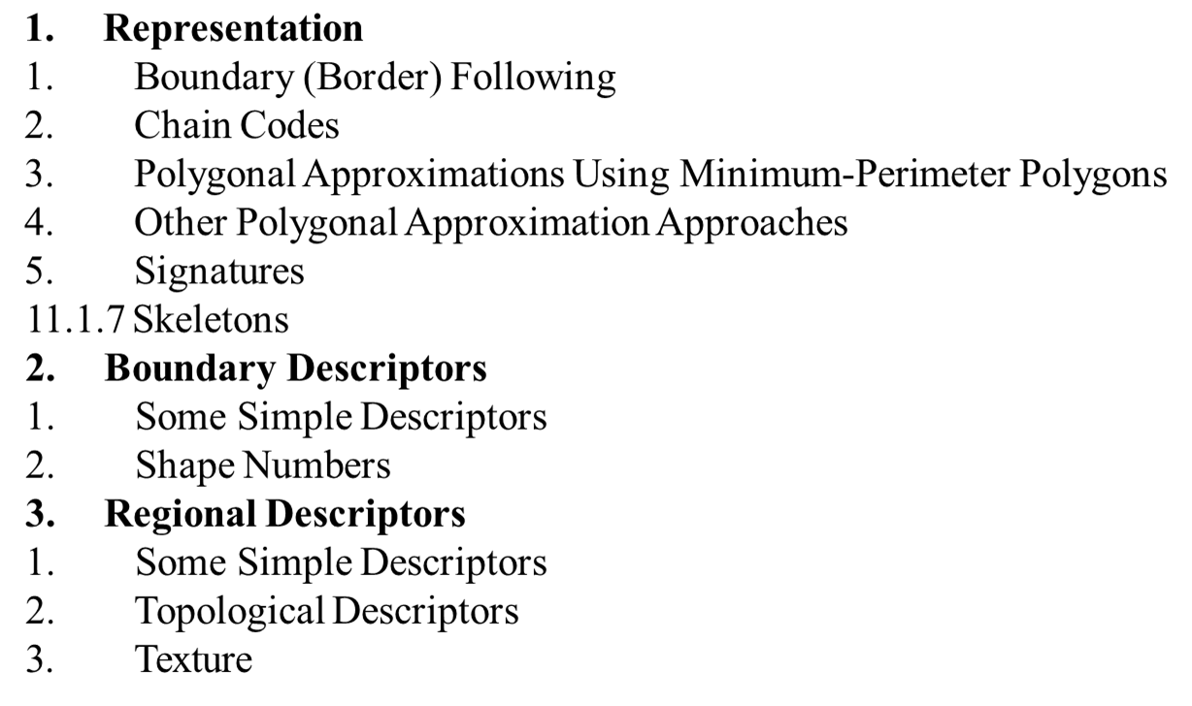
Methods for Representation and Description

Slide 5
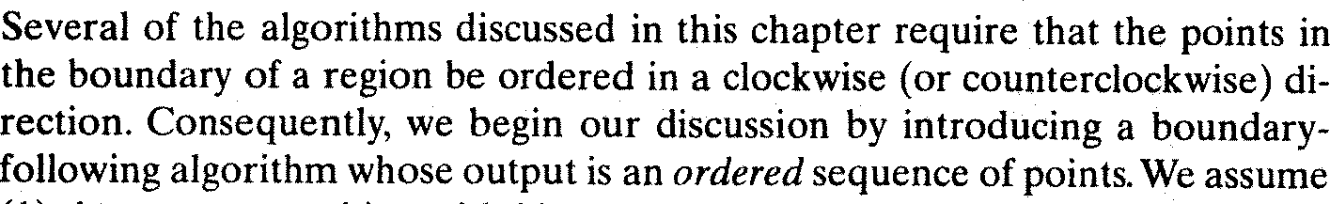
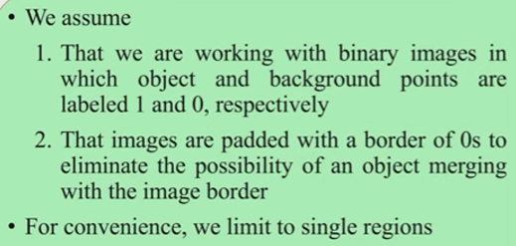
Representation:
Boundary Following:

Slide 6
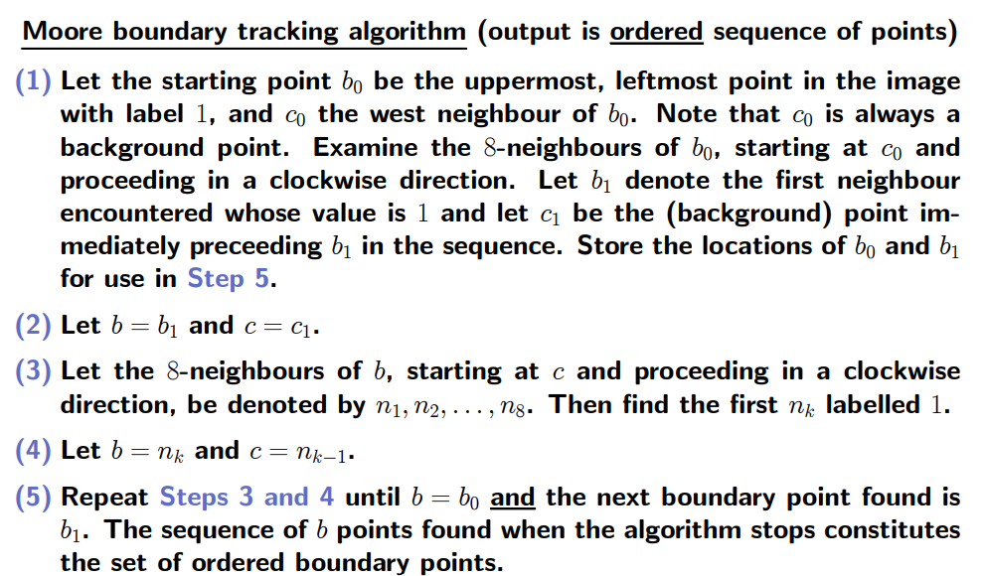
Representation: Boundary Flowing Algorithm

Slide 7
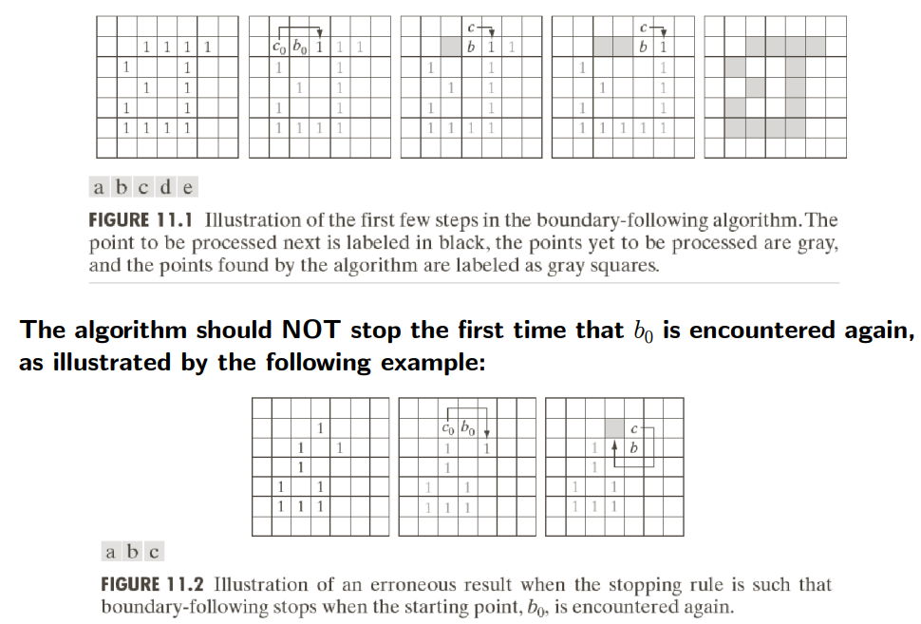

Slide 8
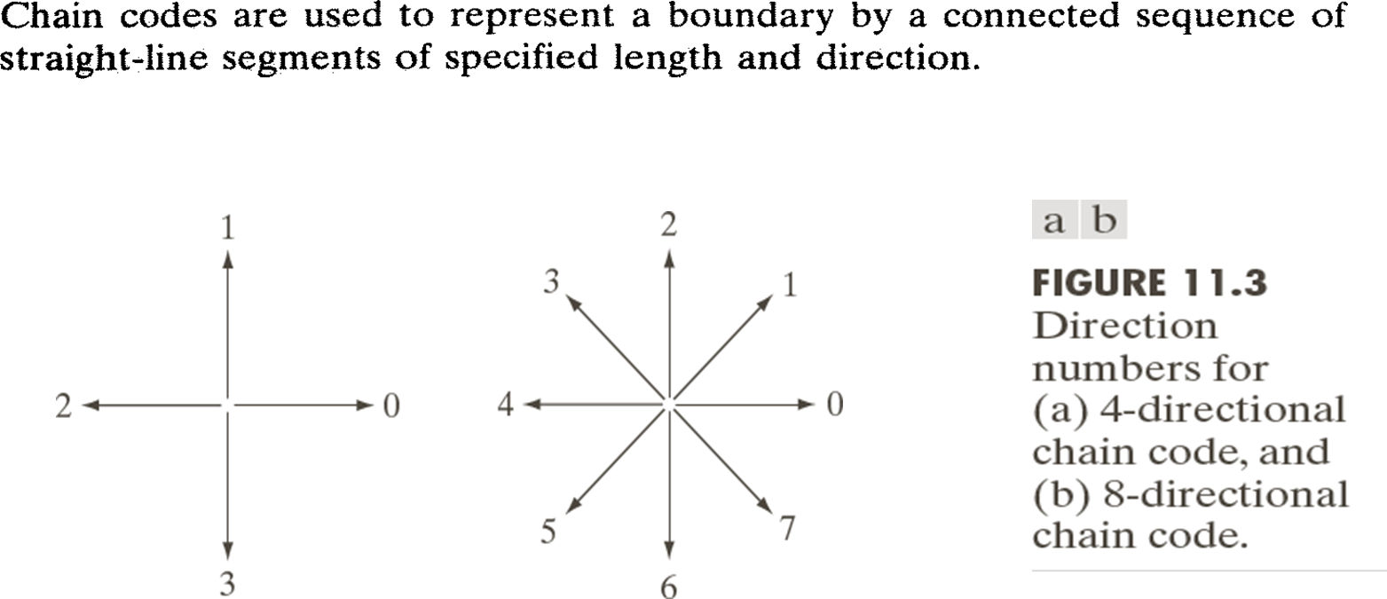
Representation: Chain codes

Slide 9
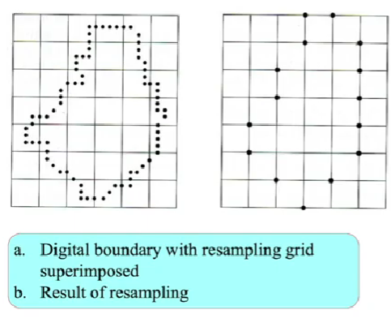
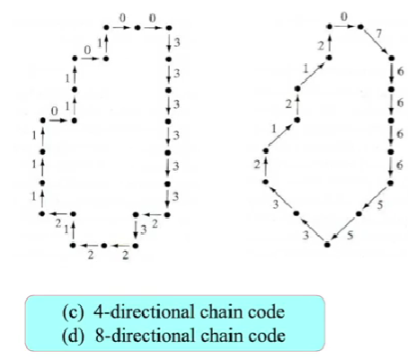
Representation: Chain codes example

Slide 10
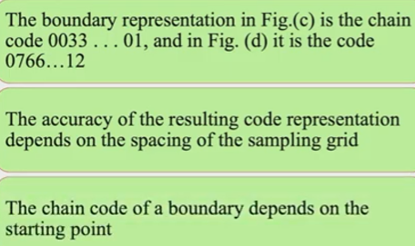
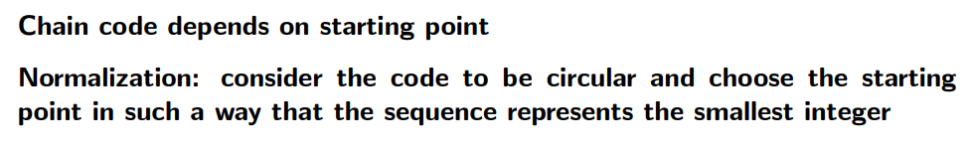
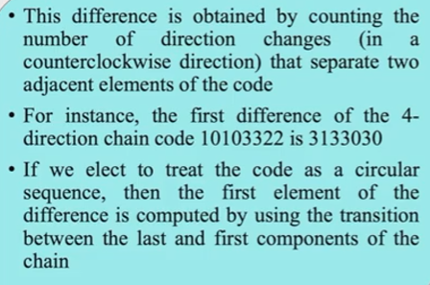
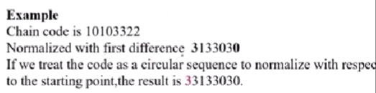

Slide 11
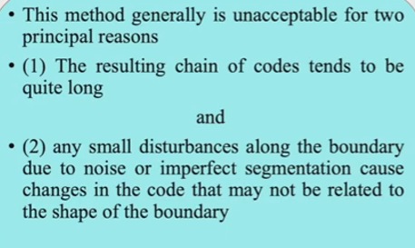
Chain code disadvantages

Slide 12
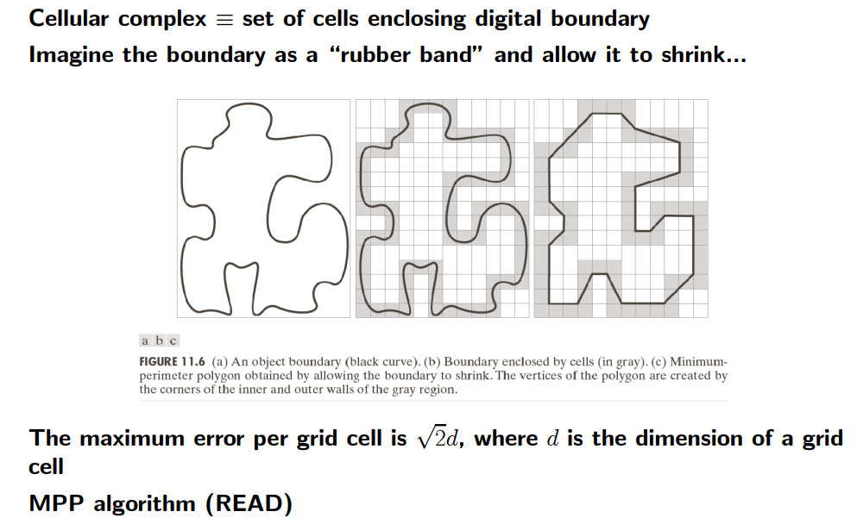
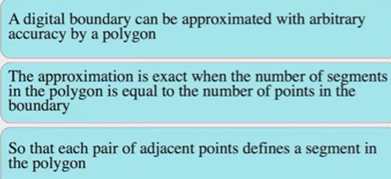
Representation: Polygon Approximation using Minimum perimeter polygon(MPP)

Slide 13
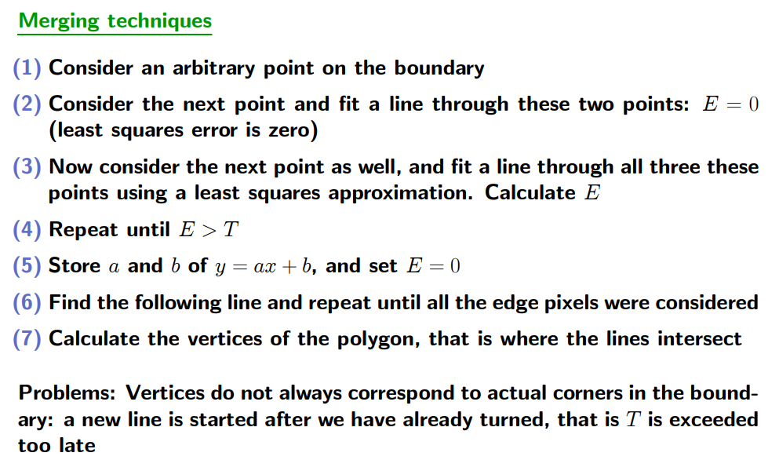
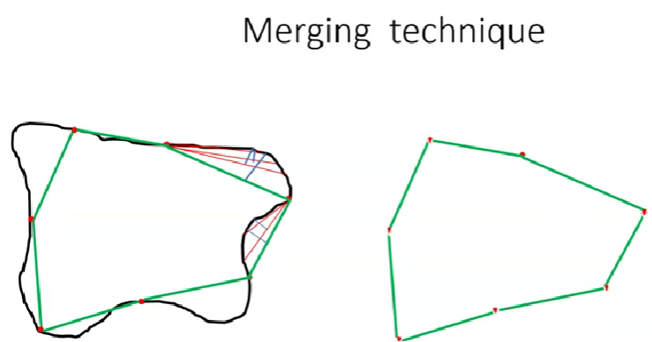
Representation: Other polygonal Approximation methods-Merging Technique

Slide 14
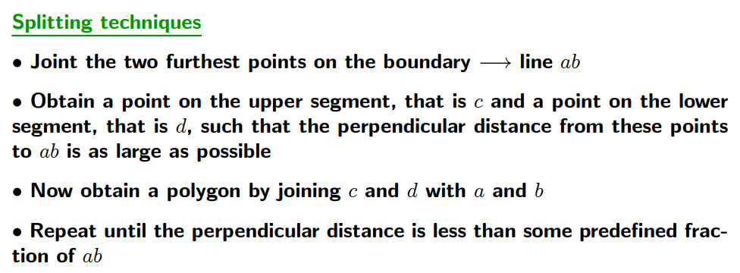
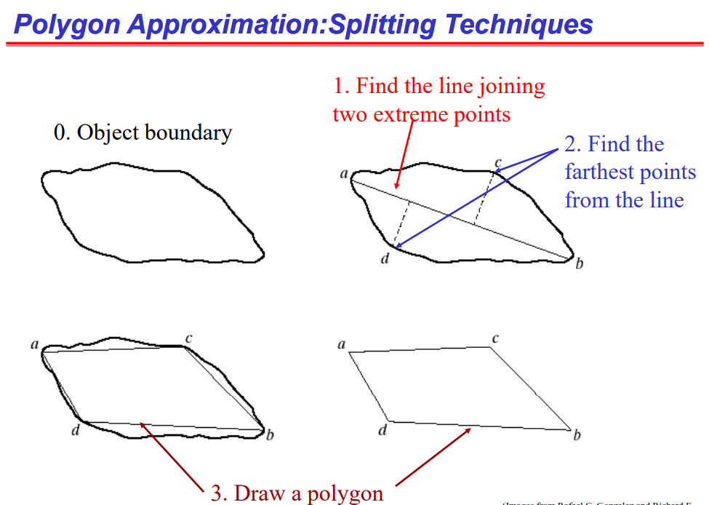

Slide 15
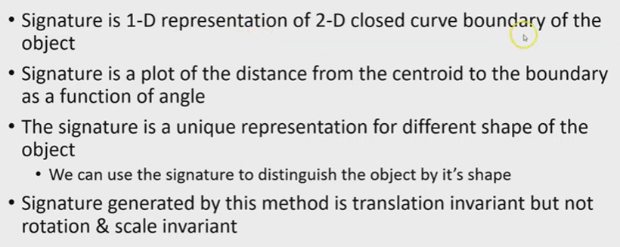
Representation: Signatures

Slide 16
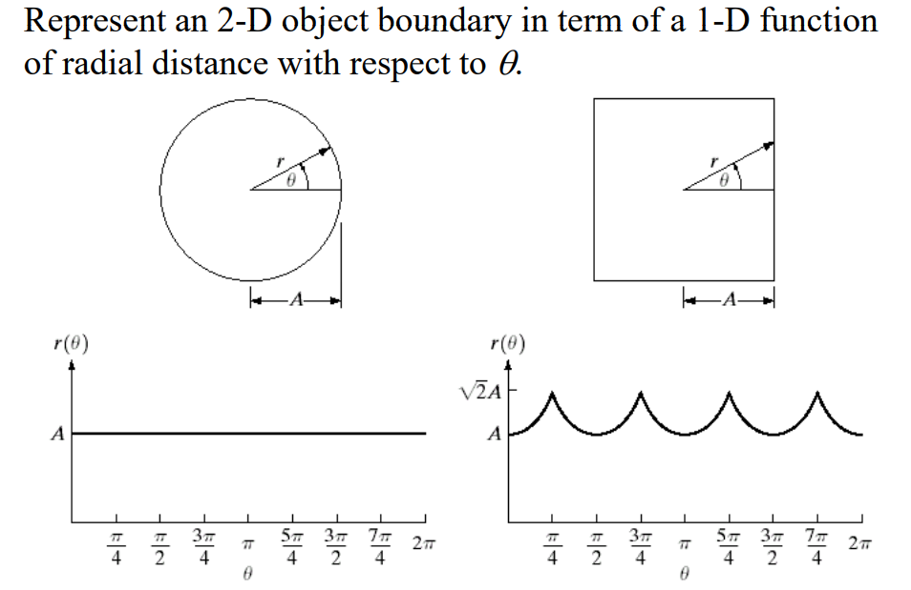
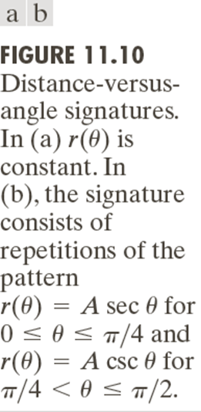
Representation: Signatures-Example

Slide 17
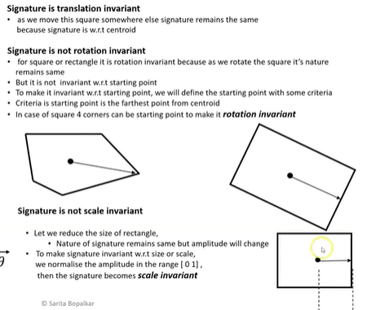

Slide 18
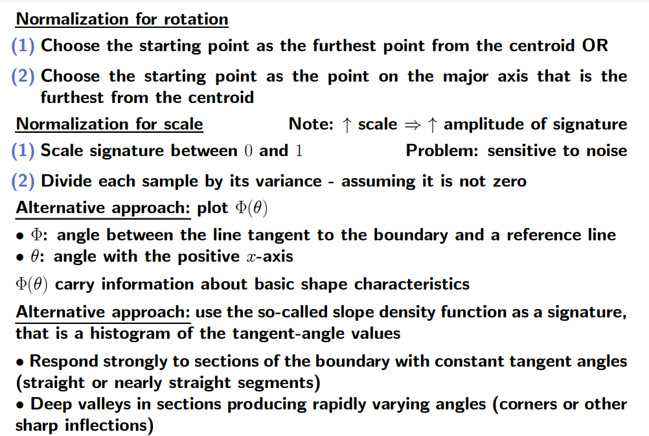

Slide 19
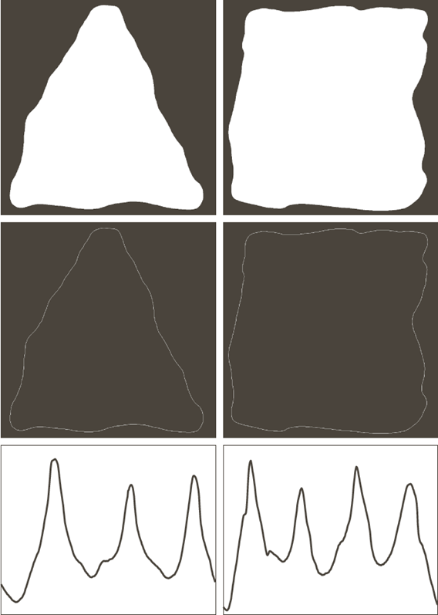
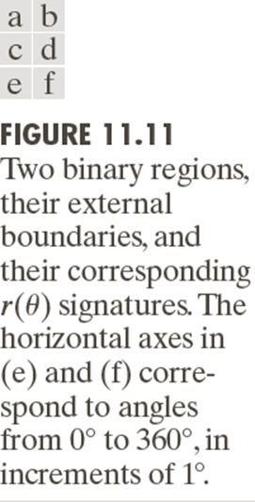
Representation: Signatures-Example

Slide 20
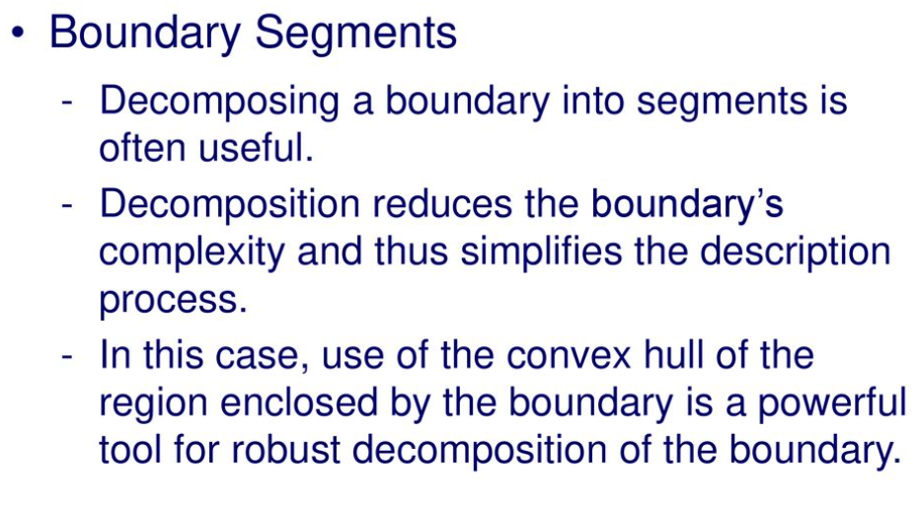
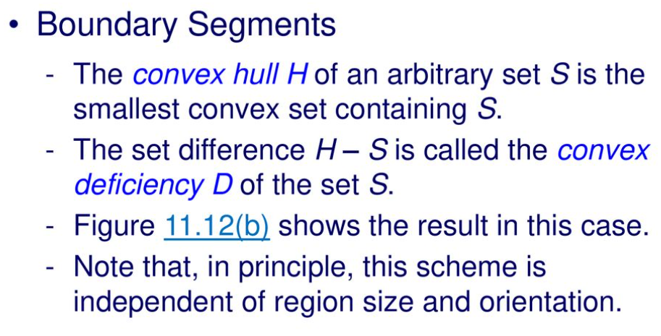
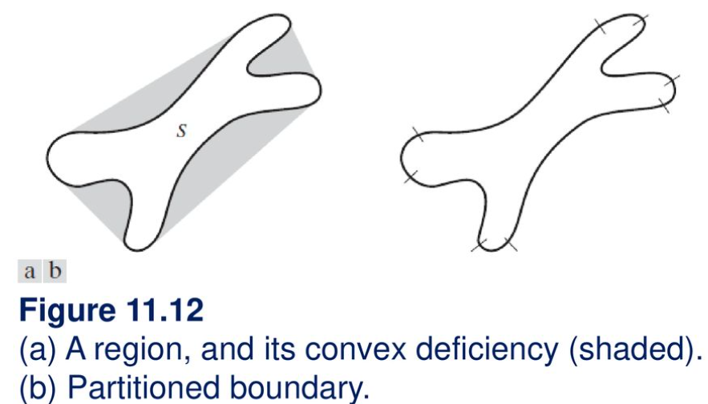
Representation –Boundary Segments

Slide 21
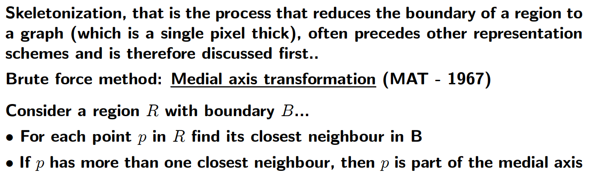
Representation : Skeleton- Medial Axis Transformation

Slide 22
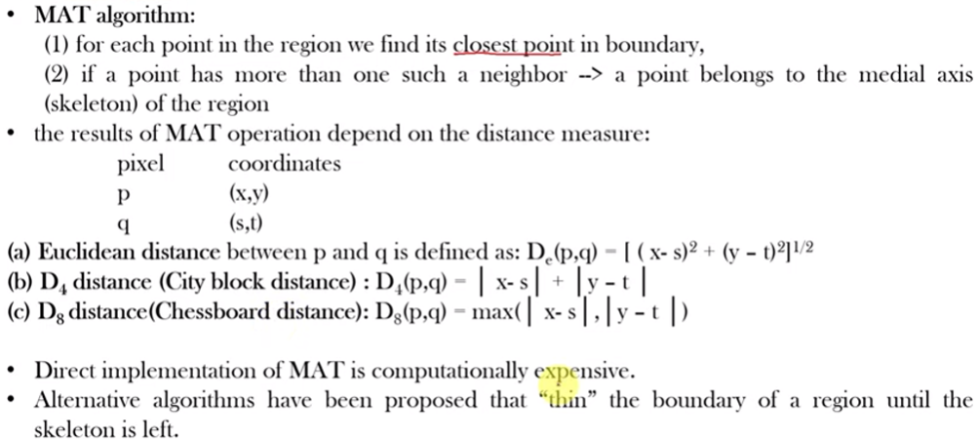

Slide 23
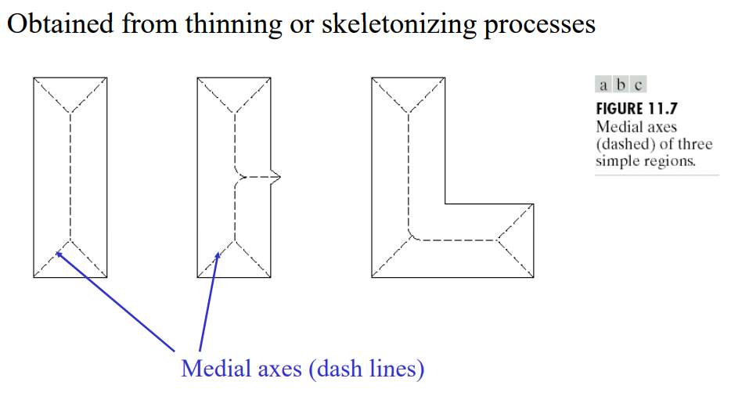

Slide 24
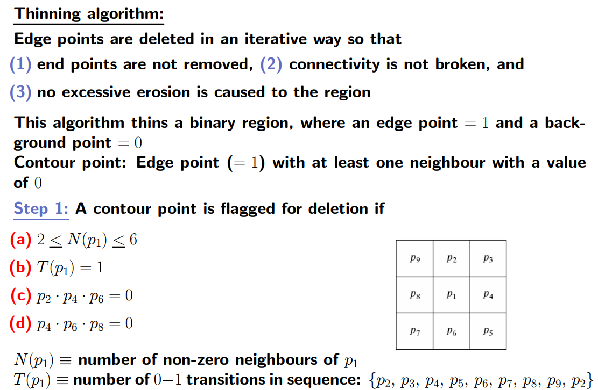
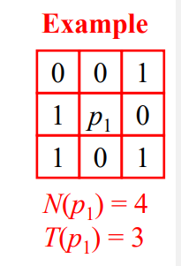
Representation : Skeleton- Thinning Algorithm

Slide 25
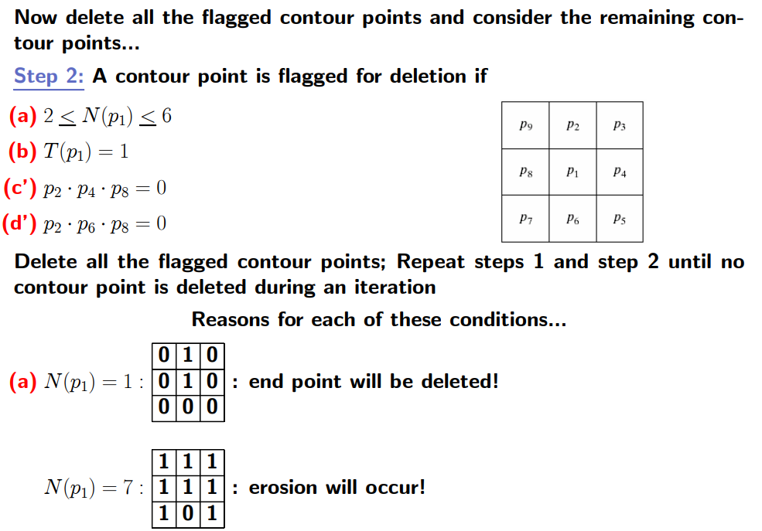

Slide 26
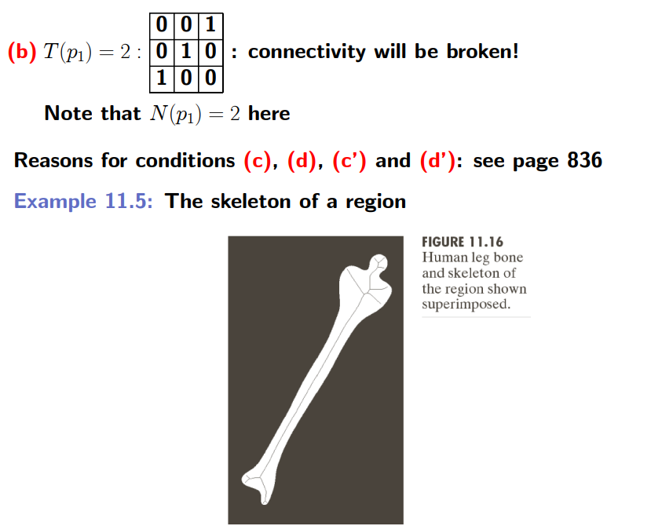
This means check isolated point at least
2-6 neighbours
b) It is not a corner or Junction point.
d) = at least any one pair is zero .
It checks it is a part of Horizontal, vertical,
Diagonal line.
C’),d’) = at least one is zero in the pair. It
Check part of opposite diagonals.
After checking all only make it as zero.
The above are the algorithm explanation.

